Slide 1



Moogle

Slide 2
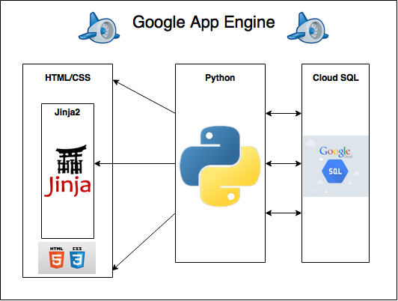
Complete System Framework

Slide 3
Demo
Requirements:
Creating new user, browsing, searching, buying a sale item, bidding on an auction item, posting a new auction item
Extras:
Email alerts (when signing up and buying a sale item), watchlists, herd membership, “Related Items” section on product pages
http://moogle-store.appspot.com

